Slide 1
Kate Hardy MOOC Intro to Web Dev
MOOC Challenge Oct 2023

Slide 2
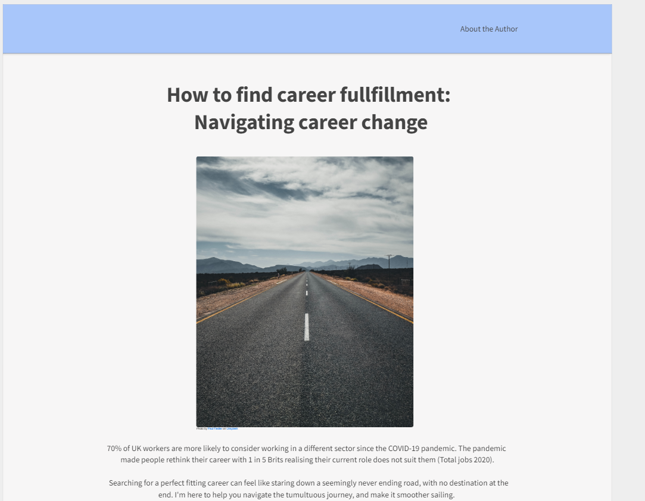
https://app.moqups.com/84xFbzmykjMpgw7iyn6b72mVZT0attUw/view/page/a8b49fd9f
Wireframe

Slide 3
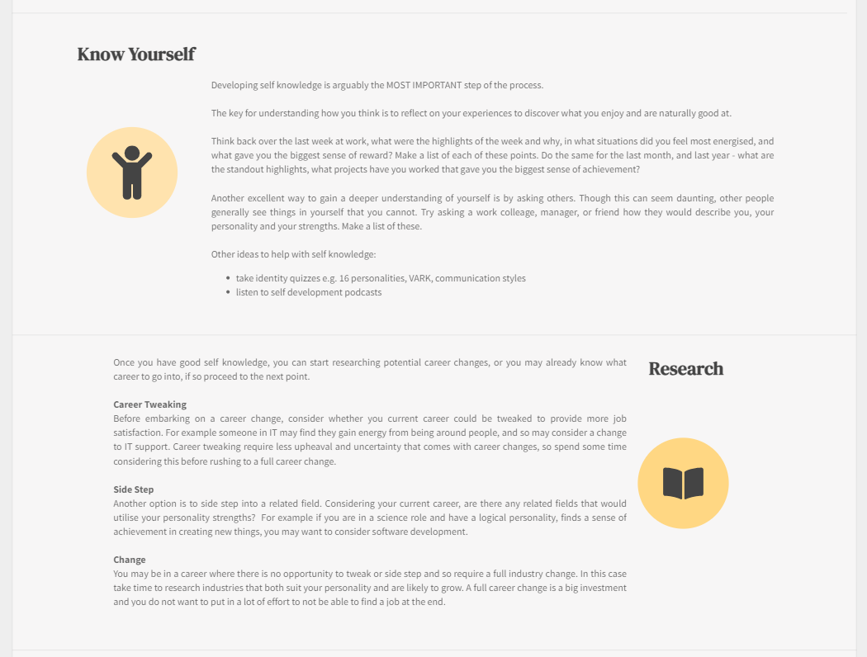
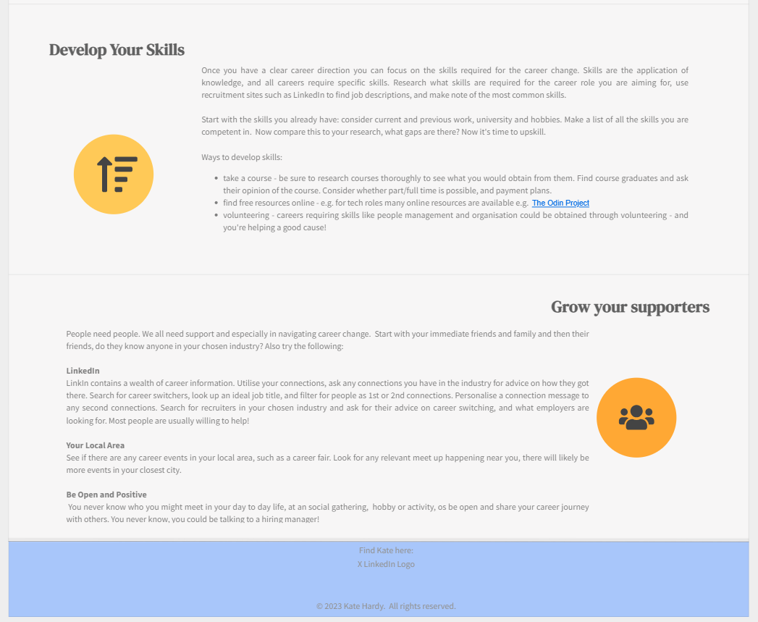
Main HTML page

Slide 4
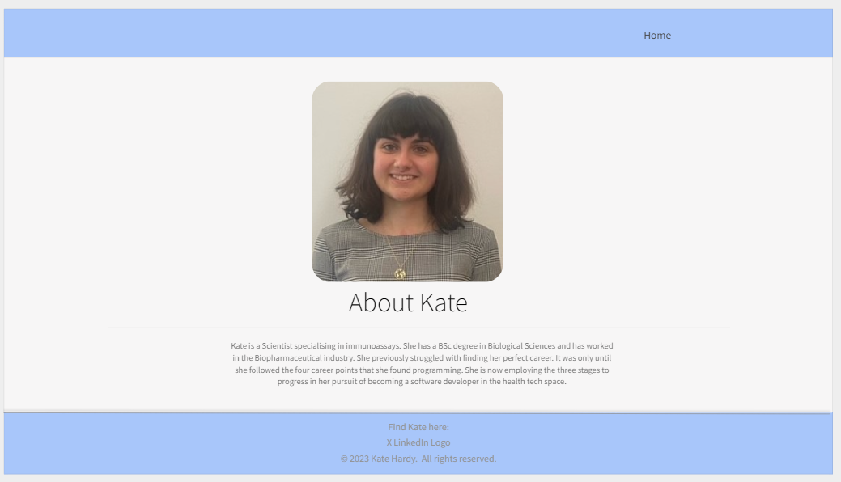
Second HTML page

Slide 5
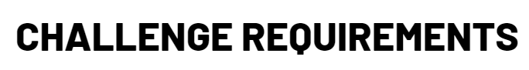
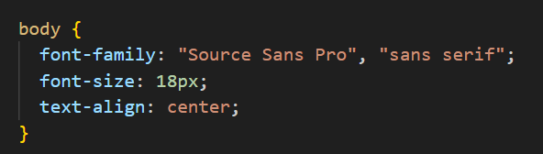




A minimum of 2 HTML web pages and one external CSS file and one external JS file
Consistent styling through the website
All links and buttons working

Slide 6
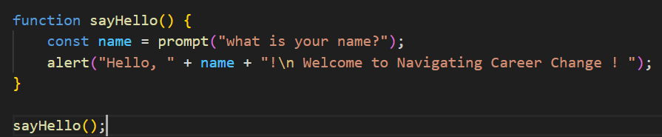
Basic JavaScript user interaction
Effective use of classes and IDs
Use classes for repeating items e.g. bold text
Use IDs for single use item e.g. photo

Slide 7
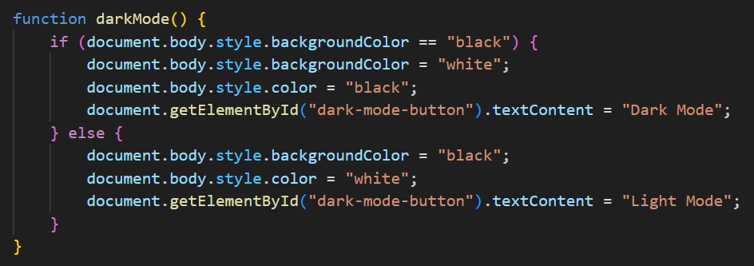
Creative DOM manipulation (e.g Dark Mode, animations, etc)
Created dark mode button that changes to light mode

Slide 8
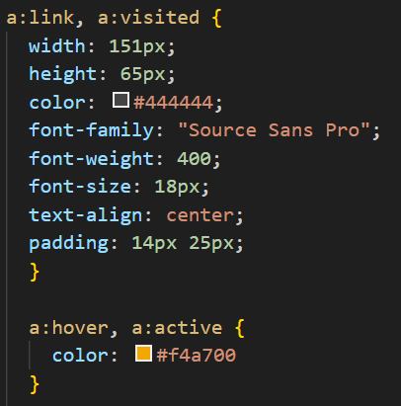



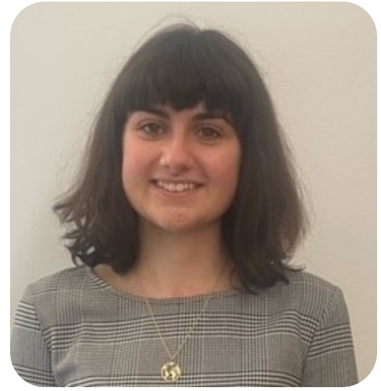
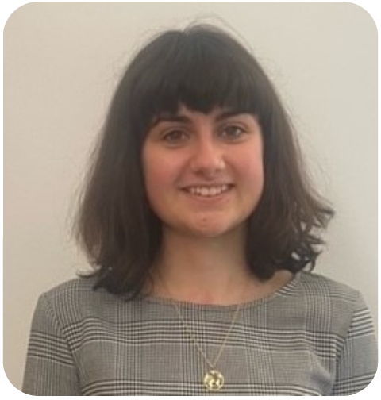
Additional features
CSS stylings:
Web page links change to orange when mouse over
Flip profile photo on About the Author page

Slide 9

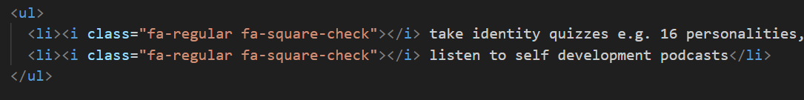
Additional features
Font Awesome Icons:
Unordered list with icons:

Slide 10
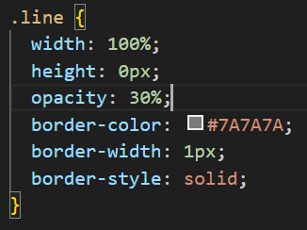
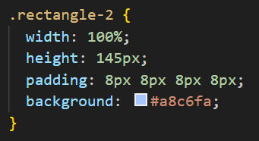
Additional features
Shapes

Slide 11
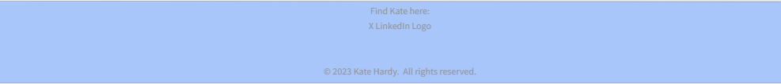

Ongoing Challenges…
Aligning text to left and right of page – difficulty with text-align not working. Next steps to try grid layout.
Layers – adding elements on top of each other e.g. circle behind icon, add text on top of header and footer rectangle borders . Tried using z –relative positioning, further investigating needed.

